Slide 1
Smart Perfume Mixer
Distributed systems/ advanced Embedded systems
29.06.2022. Chaotic-Workers

Slide 2
Internet of Things
Network
Embedded with sensors
Software
Purpose of connecting
Exchanging data
Motivation For project

Slide 3
Smart Perfume Mixer
Processes
Collecting ingredients
Blending
Extracting oils
Aging
Quality Control

Slide 4
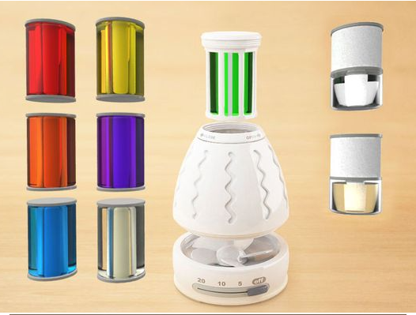
Applications
Smart Control of Freshness
Pseudo Autonomous function
Remote Control

Slide 5
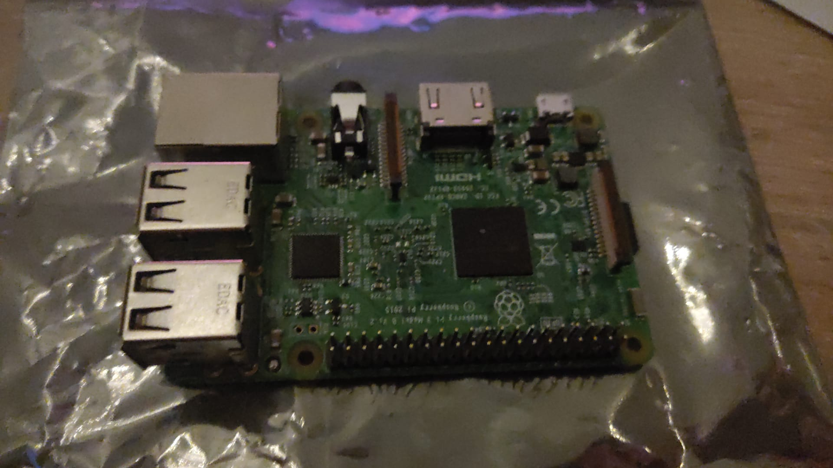
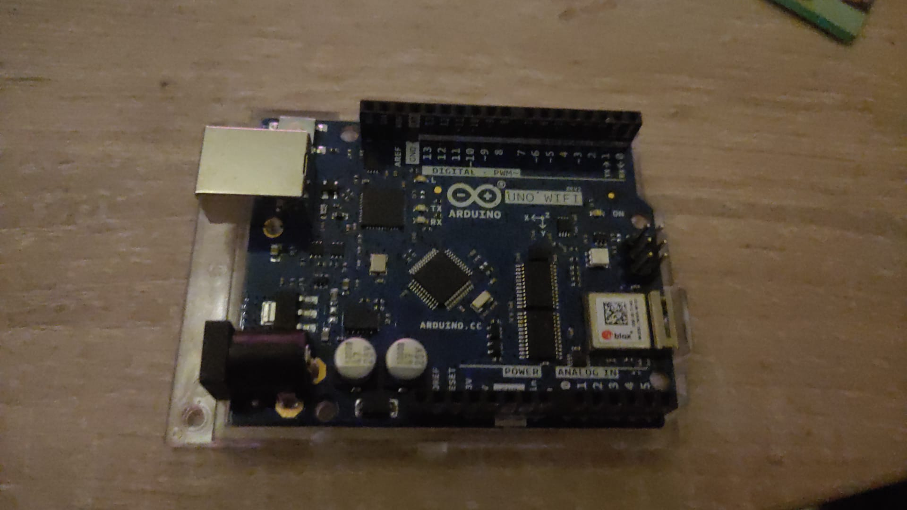
RASPBERRY PI
ARDUINO
MQTT
HTTP

Slide 6
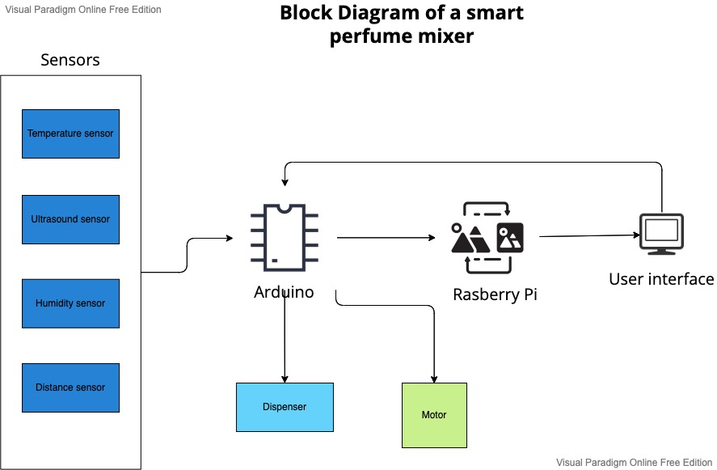

Slide 7
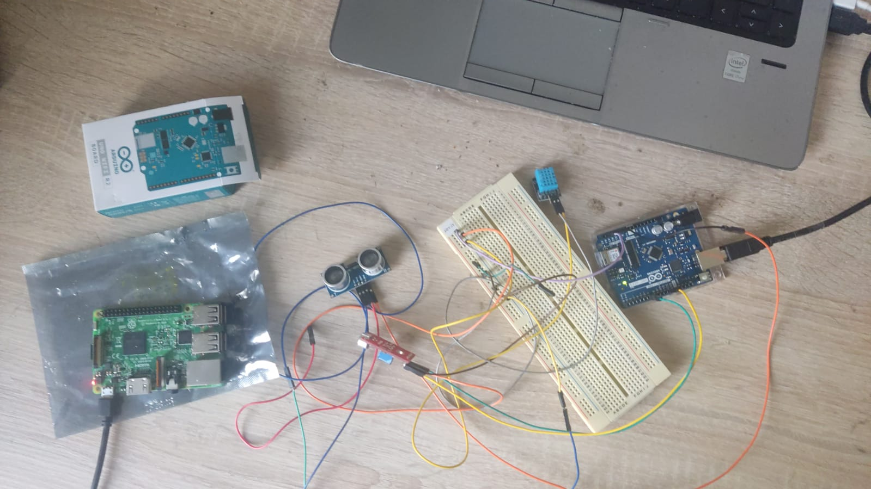

Slide 8
References
https://www.prosec-networks.com/blog/internet-of-things/
https://www.alibaba.com/product-detail/High-Quality-Perfume-Mixer-and-Freezing_1600243829540.html
https://www.pinterest.com/pin/357121445421835703/visual-search/?x=10&y=10&w=530&h=397&cropSource=6&imageSignature=1ca92d4f2e50c21ab0a065478a901972

